Slide 1
Team Nock-Nock
Dev Team:
Nathan Davids
Okuhle Charlieman
Cole Hanekom
Kiran Isaacs

Slide 2
The Mzamomtsha Primary School Scenario
Location
Drift Sands
Main Goal:
Expansion
Problems:
No Online Presence
Infrastructure
Staff

Slide 3
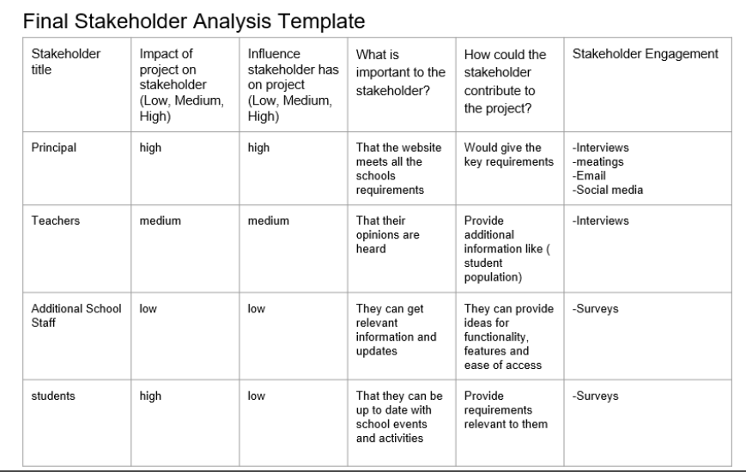
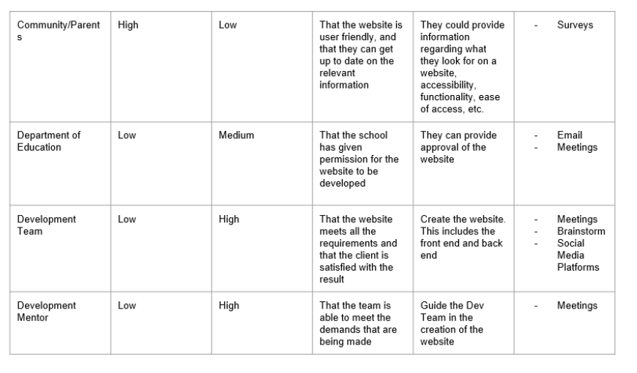
Stakeholder Analysis Report

Slide 4
Stakeholder Requirements Gathering
Personal Interviews
Surveys/Questionnaires
Group Discussions
Internet Data

Slide 5
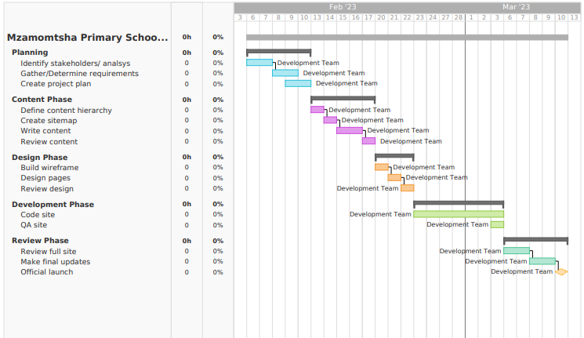
Project Plan

Slide 6
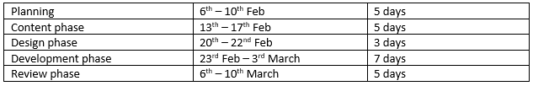
Project Plan Review
scope :
Online presence/ expansion
Raise awareness/Notifications (events, vacancies, community, investors)
Timeline:

Slide 7
Thank you

